Slide 1


Slide 2

DIRECTED STUDY PRESENTATION
COMPARATIVE EVALUATION OF LARGE LANGUAGE MODELS FOR E-COMMERCE ADVERTISEMENT GENERATION:
A SURVEY-BASED ANALYSIS
PRESENTED BY: SAKTHI MAHALAKSHMI SANKAR
Department of Computer Science | August 26,2025
Notes:
Good afternoon. I’m Sakthi Mahalakshmi Sankar, and today I’ll be presenting my directed study project: Comparative Evaluation of Large Language Models for E-Commerce Advertisement Generation.
We all see ads every day—some catch our attention, most don’t. The question driving this project was: can AI create ads that are just as effective as those written by humans? That’s what I set out to investigate.

Slide 3
About the Project
Goal: Benchmark commercial LLMs for automated e-commerce advertisement creation (copy + images)
Models Used: Claude 3.5 Sonnet, GPT-4o, Gemini 1.5 Pro, DeepSeek V2.5
Approach: Generate ads using AI, compare with human-created ads via controlled survey evaluation
Scope: 5 product categories, 13 ad generation conditions, 184 evaluations
Outcome: Empirical evidence on performance, cost-efficiency, and scalability of AI ads
Notes:
This project is about combining LLMs with image generation tools to create full advertisements. Why is this interesting? Because traditional ad creation takes a lot of time, money, and creativity, while LLMs can produce text and visuals in seconds.
In my study, I generated ads using both humans and AI, tested them on real participants, and statistically analyzed whether there were performance differences. The goal was to answer a simple but impactful question: should businesses trust AI for ad creation?

Slide 4
Problem Statement
High Cost: Creative professionals are expensive, especially at scale
Slow Turnaround: Manual ad creation delays campaign agility
Quality Variability: Human-created content varies in tone & style
Scalability Challenges: Difficult to produce diverse ads for large catalogs
Research Gap: Limited empirical evaluation of LLM ads in real commercial settings
Notes:
Here’s the problem. Traditional ad workflows are: expensive, slow, and inconsistent. A human copywriter might spend hours writing a few versions, and a designer might take days to make the visuals.
For businesses with hundreds or thousands of products, this doesn’t scale. The question becomes: if AI tools can generate ad text and images instantly, will the audience still find them convincing, clear, and trustworthy? Or will people reject AI ads because they feel artificial? That tension motivated this study.

Slide 5
Research Gap
Most LLM advertising studies focus on content generation but not comparative perception with human ads.
Lack of controlled experiments in real e-commerce contexts.
Need for multi-dimensional evaluation (Purchase Intent, Visual Appeal, Value Convincing, Message Clarity, Trustworthiness).
Notes:
Research on generative AI has exploded, but there are gaps. Most papers test AI output quality, not consumer perception. Many focus on text only, ignoring images. And very few look at comparisons between AI and human-generated ads across multiple dimensions like clarity, trust, and persuasiveness.
So the gap is: we don’t yet know if consumers see AI ads as better, worse, or equal to human ones. Filling that gap is crucial for both academia and industry.

Slide 6
Objectives
Primary Objective:
Benchmark state-of-the-art LLMs for automatic ad generation
Secondary Objectives:
Compare AI vs human ad effectiveness
Identify best LLM for copy/image
Analyze across product categories
Build reusable methodology
Provide statistical evidence for viability
Notes:
My objectives were fourfold.
First, to benchmark multiple LLMs for ad creation. Second, to compare AI ads against human ads directly. Third, to analyze results not just overall but across different products and ad dimensions. And fourth, to provide businesses and researchers with evidence-based insights on whether generative AI can be adopted at scale.
Put simply: do AI ads work, and if so, how do they compare?

Slide 7
Can AI-generated ads match
or outperform human-created ads in perceived effectiveness?
Notes:
The main research question is simple but powerful: Are AI-generated ads perceived as effective as human-generated ads?
And beneath that are sub-questions: Which LLM performs best? Are there strengths in certain dimensions like clarity or trust? And does the type of product change the audience’s perception? These guided the whole study

Slide 8
LLM Models
Model | Key Strengths | Image API
Claude 3.5 Sonnet | Strong reasoning, creative writing | DALL·E 3
GPT-4o | Multimodal, broad knowledge | DALL·E 3
Gemini 1.5 Pro | Large context, Google ecosystem | Imagen 2
DeepSeek V2.5 | Cost-efficient, analytical | Stable Diffusion XL

Slide 9
ChatGPT (OpenAI)
LLM Used: GPT-4 Turbo (OpenAI).
Copy Generation: Produced short, persuasive ad text.
Image Tool: DALL·E 3 (native to OpenAI).
Why DALL·E?
Seamless integration with ChatGPT API.
Known for clean, photorealistic images.
Minimal preprocessing → fast turnaround.
Why ChatGPT?
Industry benchmark, strong fluency, easy deployment.
Notes:
ChatGPT, powered by GPT-4 Turbo, was one of the models I tested. It was paired with DALL·E 3 for image generation, which ensured seamless integration in the OpenAI ecosystem.
I chose ChatGPT because it represents the most widely adopted commercial LLM, known for fluency, creativity, and reliable text generation. DALL·E 3 was ideal because it produces clean, photorealistic visuals directly from text prompts.
In this study, ChatGPT ads represent the industry benchmark, both in terms of market relevance and technical maturity

Slide 10
Claude (Anthropic)
LLM Used: Claude 3 Opus.
Copy Generation: Emphasis on clarity, safety, and trust.
Image Tool: DALL·E 3 .
Why DALL·E 3?
High-quality, consistent visuals across LLMs.
Ensures comparability since same image model used with ChatGPT.
Why Claude?
Strong alignment/safety focus → good for testing consumer trust perceptions.
Notes:
The second model I tested was Claude 3 Opus, paired with DALL·E 3 for images.
Claude is known for its focus on alignment and safe generation. I expected that these traits might translate into higher perceived trustworthiness and clearer messaging compared to other models. By pairing it with DALL·E, I ensured consistency in image quality across Claude and ChatGPT.
Claude’s inclusion was crucial because it represents a strong competitor to OpenAI, but with a very different design philosophy—emphasizing safety, transparency, and reliability.

Slide 11
Gemini (Google DeepMind)
LLM Used: Gemini 1.5 (Google).
Copy Generation: Concise, factual product ads.
Image Tool: Imagen 2 (Google).
Why Imagen?
Native Google integration → strongest pairing with Gemini.
Produces high-quality, aesthetic visuals.
Fits naturally into multimodal pipeline.
Why Gemini?
Represents Google’s flagship multimodal LLM.
Needed to compare against OpenAI/Anthropic.
Notes:
The third model was Gemini 1.5, Google’s flagship multimodal LLM, paired with Imagen 2 for images.
Gemini is marketed as being natively multimodal, able to handle both text and visual reasoning. Imagen 2 is Google’s advanced image generation model, known for high aesthetic quality and realistic visuals.
I included Gemini to test whether Google’s integrated AI ecosystem—designed for multimodal tasks—would provide an advantage in ad clarity, visual appeal, or overall effectiveness

Slide 12
Deepseek (Open-Source)
LLM Used: Deepseek (open-source).
Copy Generation: Generated ad copy in English.
Image Tool: Stable Diffusion pipeline.
Why Stable Diffusion?
Cost-effective, widely available in open-source ecosystem.
Works well with flexible prompts.
Why Deepseek?
Represents open-source alternative to commercial LLMs.
Shows whether low-cost models can match premium ones.
Notes:
The fourth model was Deepseek V2.5, an emerging open-source LLM, paired with Stable Diffusion for image generation.
Unlike commercial models, Deepseek is free and widely adaptable. Paired with Stable Diffusion, which is also open-source, this combination represents the low-cost, flexible alternative available to businesses.
Deepseek’s inclusion allowed me to test whether open-source models can compete with premium commercial LLMs in ad effectiveness, and whether businesses could achieve similar results without paying for costly APIs.

Slide 13
Ad Generation Modes
H: Human Copy + Human Image.
LC: LLM Copy + Human Image.
LI: LLM Image + Human Copy.
LCI: LLM Copy + LLM Image
Notes:
I tested four ad creation modes. Human-only ads served as the baseline. Then I tested hybrid ads where humans did either the copy or the image, while AI did the other. Finally, I tested full AI ads where the LLM generated both text and image.
This design allowed me to see not just AI vs. human, but also whether hybrid collaboration was more effective than either alone.

Slide 14
Experimental Design
Products Tested: T-shirt, Coffee Mug, Umbrella, Backpack, Phone Case.
Ad Variants: 13 total (1 human baseline + combinations per LLM).
Survey Method: Participants rated each ad on a 1–5 Likert scale across 5 dimensions.
Collected Data: Demographics, shopping frequency, survey completion time.
Dimensions rated:
Purchase Intent
Visual Appeal
Value Convincing
Message Clarity
Trustworthiness
Notes:
I used five product categories—T-shirt, Coffee Mug, Umbrella, Backpack, and Phone Case. For each, I had 13 ad variants.
Participants rated these ads on five key dimensions: purchase intent, visual appeal, value convincing, message clarity, and trustworthiness. These dimensions reflect both persuasion and perception—critical for real-world ads.”

Slide 15
Statistical Analysis Plan
Step 1 – Assumption Checks:
Shapiro–Wilk → normality.
Levene’s & Bartlett’s → variance equality.
Step 2 – Main Test:
Welch ANOVA (robust to unequal sample sizes/variances).
Step 3 – Effect Size:
η² (eta-squared) → variance explained.
Step 4 – Post-hoc:
Games–Howell test planned but not required (no significant results).
α = 0.05 threshold for significance.
Notes:
To analyze the data, I first checked assumptions of normality and variance equality using Shapiro-Wilk and Levene’s tests. Then I ran Welch ANOVA, which is robust to unequal group sizes. I calculated eta-squared as an effect size measure. And I planned Games–Howell post-hoc tests, though they weren’t needed since no significant results emerged.
So my analysis was statistically rigorous and transparent.”

Slide 16
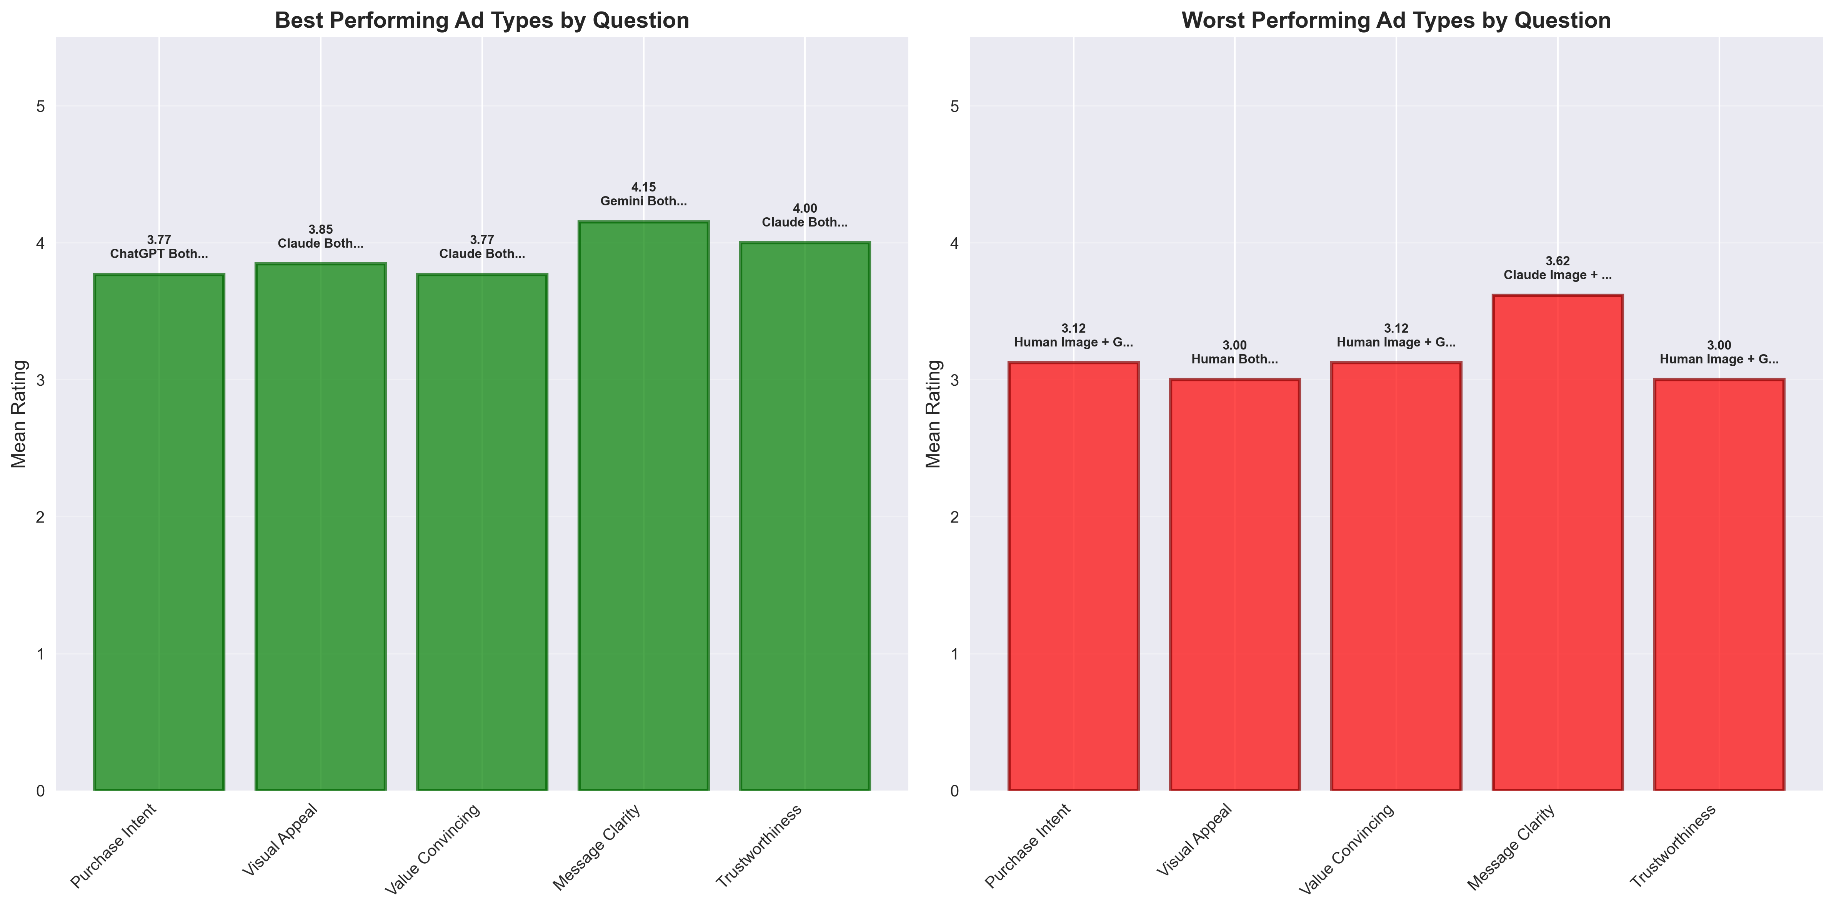
Results From 13 Variants → 5 Models
From Creative Variants to Model-Level Comparison
Initial analysis: 13 ad variants (Human + 12 AI setups).
Welch ANOVA: F(12, 65.7) = 0.498, p = 0.909 → non-significant.
Challenge: small sample sizes (≈13–16 per variant).
Collapsed into 5 groups: Human, ChatGPT, Claude, Deepseek, Gemini.
Improves statistical power and aligns with research question.
Notes:
In the first stage, I analyzed all 13 variants: the human baseline plus 12 AI setups.
Welch ANOVA gave F(12, 65.7) = 0.498, p = 0.909. This means that across 12 degrees of freedom between groups and 65.7 adjusted degrees of freedom within groups, the test statistic was very small, with a high p-value.
Interpretation: the probability of observing these differences by chance is 91%, which is far above the 5% threshold. Therefore, no statistically significant differences existed.
Because group sizes were small (n ≈ 13–16 per variant), I collapsed into 5 model-level groups: Human, ChatGPT, Claude, Gemini, and Deepseek. This improved statistical power and directly aligned with my research question.

Slide 17
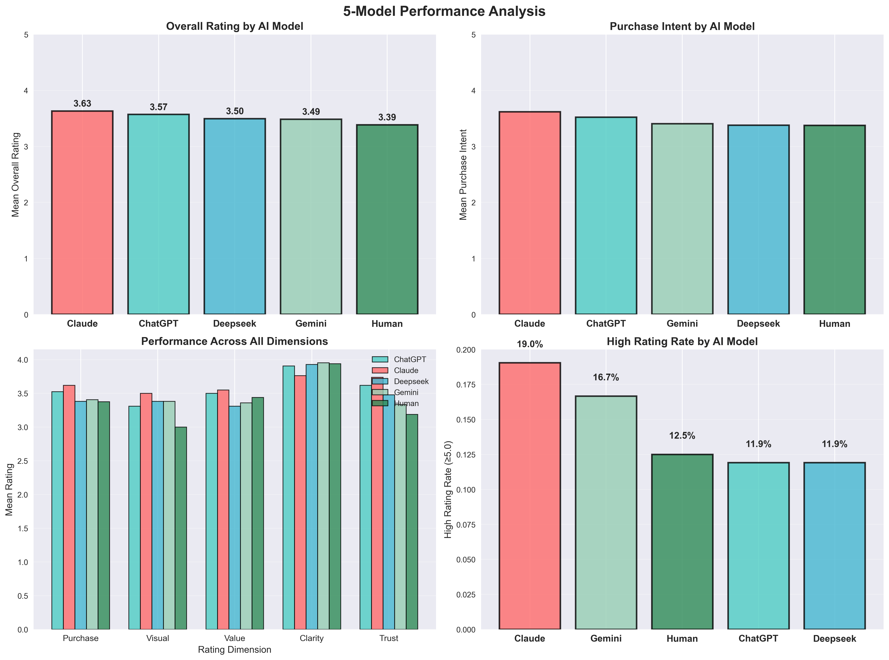
5-Model Welch ANOVA Results
Welch ANOVA: F(4, 68.9) = 0.213, p = 0.931
Effect size: η² = 0.0054 → negligible
Conclusion: No significant differences between Human and LLMs.
Notes:
At the model level, Welch ANOVA gave F(4, 68.9) = 0.213, p = 0.931.
Here, 4 degrees of freedom represent the comparisons between the five groups, and 68.9 adjusted degrees of freedom represent the within-group variability after correcting for unequal variances.
The p-value of 0.931 means there is a 93% probability that the observed variation is due to chance. Effect size η² was only 0.0054, which is negligible.
So, even under robust statistical testing, I found no evidence of differences between human and LLM-generated ads. This is strong evidence for parity.”

Slide 18
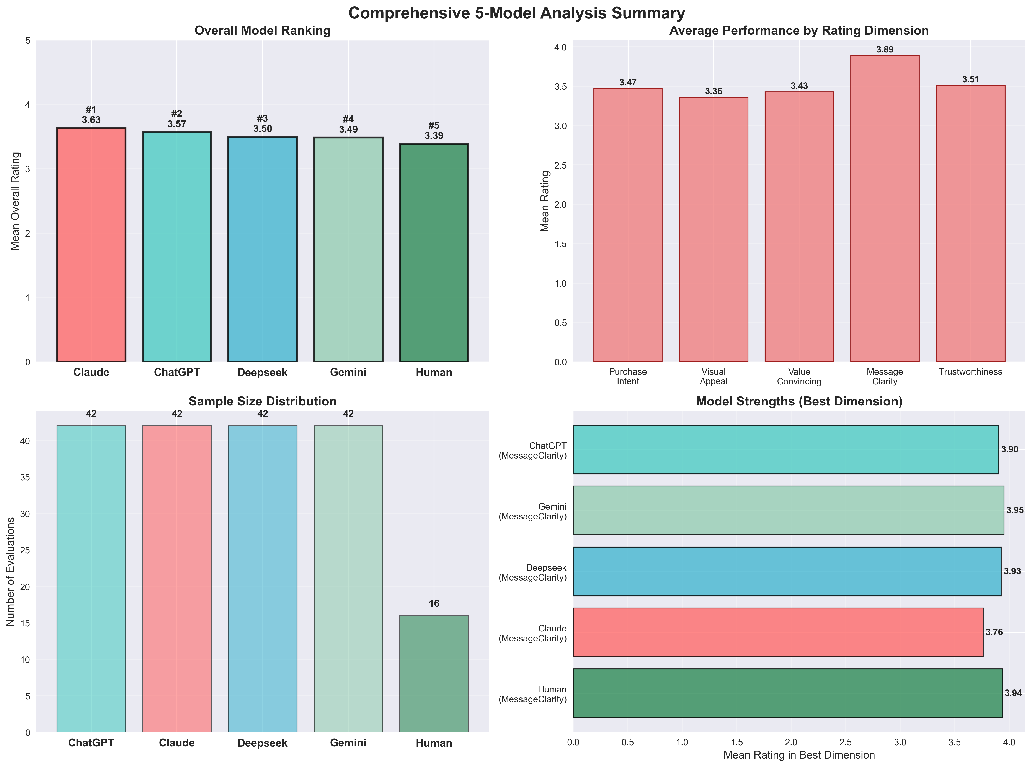
Model Ranking
Claude – 3.633
ChatGPT – 3.571
Deepseek – 3.495
Gemini – 3.486
Human – 3.388
➡ LLMs slightly higher, but not statistically significant.
Notes:
Although the differences were not significant, the descriptive means provide some interesting insights.
Claude scored highest at 3.63, followed by ChatGPT at 3.57, Deepseek at 3.50, Gemini at 3.49, and Human at 3.39.
What’s notable is that all four LLMs scored slightly higher than the human baseline, suggesting that, at minimum, AI ads are not weaker than human ads. But because the p-value was not significant, I cannot statistically claim that one model outperforms the others.

Slide 19
Descriptive Statistics
Human ads: lowest mean, highest variance (1.42) → more divided opinions.
LLMs: ratings more consistent (variance ≈ 1.0).
Suggests participants viewed AI ads more uniformly.
Notes:
One striking result: human ads had the highest variance. Participants were divided—some liked them, some didn’t. In contrast, AI ads were rated more consistently.
This suggests that AI provides a kind of baseline quality—less risky than relying on individual human creativity.

Slide 20
Dimension-Level Insights
Dimensions: Purchase Intent, Visual Appeal, Value Convincing, Message Clarity, Trustworthiness.
All non-significant (p > 0.4).
Perceptions stable across all dimensions.
Trustworthiness: Claude slightly higher.
Message Clarity: Gemini & ChatGPT strong.
Visual Appeal: LLMs > Human.
None were statistically significant.
Notes:
When I break results down by dimension: LLMs generally outperformed humans in Visual Appeal and Value Convincing. Claude scored high in Trustworthiness, while Gemini and ChatGPT were strong in Message Clarity.
The human baseline only came close in Message Clarity, but overall AI was more consistent.

Slide 21
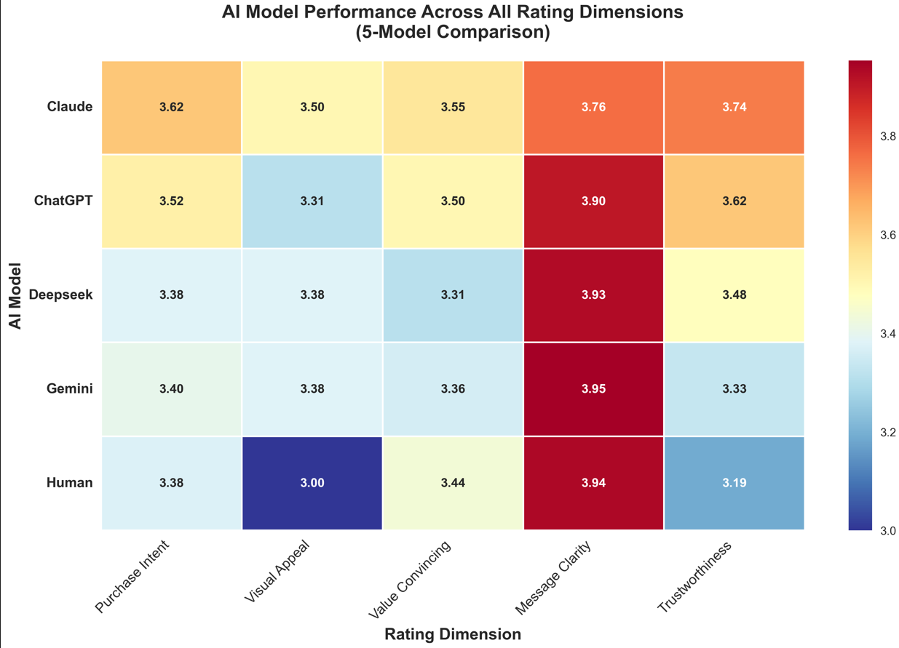

Slide 22
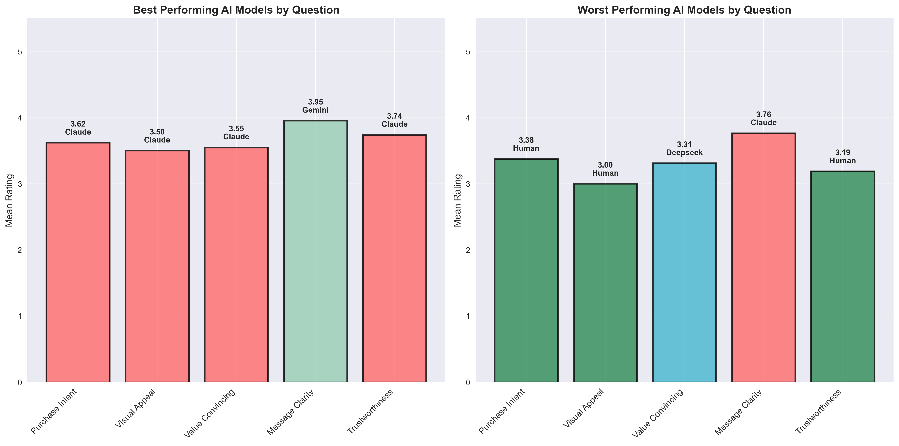
Best vs Worst Performers
Best: Claude leads in Purchase, Visual, Value, Trust; Gemini tops Message Clarity.
Worst: Human lowest in 3/5 dimensions, Deepseek lowest in Value, Claude lowest in Message Clarity.
Notes:
The best ads overall were full AI ads—Claude Both and ChatGPT Both. The worst ads were human-only or human image combined with AI text.
This shows that when left entirely to AI, ads were rated higher, while hybrid setups were less effective.

Slide 23
Results Summary
13-Variant ANOVA → No significant differences.
5-Model ANOVA → No significant differences.
Model ranking: Claude > ChatGPT > Deepseek > Gemini > Human.
Dimensions: Stable, no differences.
Strengths/weaknesses: Claude most consistent, Human lowest in visuals.
Notes:
In summary: across both 13-variant and 5-model tests, no significant differences emerged. Claude and ChatGPT trended slightly higher, humans trended lower, but statistically, all were on par.
So the key message is: AI ads are just as effective as human ads in consumer perception.

Slide 24
Key Insights
Parity between Human and AI: No significant differences → AI ads perceived as equally effective.
Consistency advantage: LLM ads had lower variance, showing more stable audience reception.
Claude’s edge: Slightly higher means across 4/5 dimensions → best overall reliability.
Human weakness: Human ads scored lowest in Visual Appeal → possible bias toward professional polish of AI-generated ads.
Notes:
Here are the three biggest insights.
Parity: AI ads perform as well as human ads.
Consistency: AI ads have less variance, making them more reliable.
Claude’s edge: Slightly higher trust and overall performance.
This shows AI isn’t just catching up—it’s competitive.

Slide 25
Why No Significant Differences?
Sample size effect: 42 per AI group vs 16 human → power imbalance.
Survey limitations: Subjective perception ≠ real consumer behavior (no CTR, no sales conversion).
Product neutrality: Everyday items (not emotionally charged products).
Ceiling effect: Ratings clustered in the 3.3–3.9 range → narrow scoring band reduced differentiation.
Notes:
Why didn’t I see big gaps? A few reasons.
The human sample size was much smaller. There was high within-group variance. Products tested were everyday items, not emotionally charged ones. And ratings clustered in a narrow band—between 3.3 and 3.9—leaving little room for separation.

Slide 26
Practical Implications for Industry
AI can safely replace or augment humans for ad copy/imagery → cost & speed savings.
Businesses can mix models (Claude for persuasion, Gemini for clarity).
Audience does not penalize AI content → removes adoption risk.
Future: AI can scale ad personalization far beyond human capacity.
Notes:
For businesses, this is good news. It means there’s no penalty for using AI ads.
Companies can safely adopt LLMs to save cost and time. They can even strategically mix models—Claude for trust, Gemini for clarity. AI provides speed and scalability while still meeting consumer expectations.

Slide 27
Limitations
No real campaign metrics (impressions, CTR, conversions).
Narrow product set (low-involvement items only).
Single exposure design → real marketing involves repetition & retargeting.
Prompting unoptimized → off-the-shelf generation, not fine-tuned for persuasion.
Notes:
Of course, there are limitations. My study was survey-based—so perception only, not real-world engagement like CTR or conversions.
I tested only five low-involvement products. Ads were static, not interactive. And I didn’t fine-tune prompts—just off-the-shelf usage.
These limitations highlight where future work should go.

Slide 28
Roadmap & Future Work
Expand sample size with balanced human & AI groups.
Test with real engagement data (ads deployed on FB/IG marketplace).
Experiment with prompt engineering & fine-tuning for persuasive effectiveness.
Investigate hybrid workflows (AI drafts + human curation).
Explore cross-modal personalization (different ads by demographic clusters).
Notes:
Looking ahead, the next step is to expand samples, test with real campaigns, measure behavioral metrics, optimize prompts, and explore hybrid workflows where AI generates drafts and humans refine them.
This is where real business adoption will benefit most.

Slide 29
THANK YOU !!!
Notes:
Thank you for your time. To conclude: AI ads perform as well as human ads, with Claude and ChatGPT trending slightly higher.
The big picture is that AI can provide scalable, cost-effective solutions for ad creation without sacrificing effectiveness. I’d be happy to take any questions.

